Slide 1
A lncRNA-disease association prediction model based on the two-step PU learning and fully connected neural networks
Hou Biyu, Tan GuangWen, Zeng Ming, Guan Lixin, Li Mengshan

Slide 2
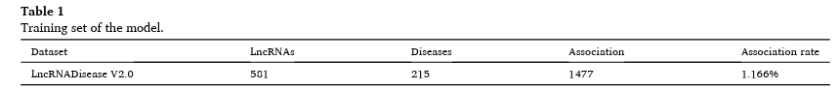

Selected Points
lncRNAs
potential association between lncRNA and diseases
characteristics of the associated data were seldom explored
PU
COPTLDA
AUC
What others did(3 calculations examples)
Datasets(lncRNADisease Database V2.0)

Slide 3
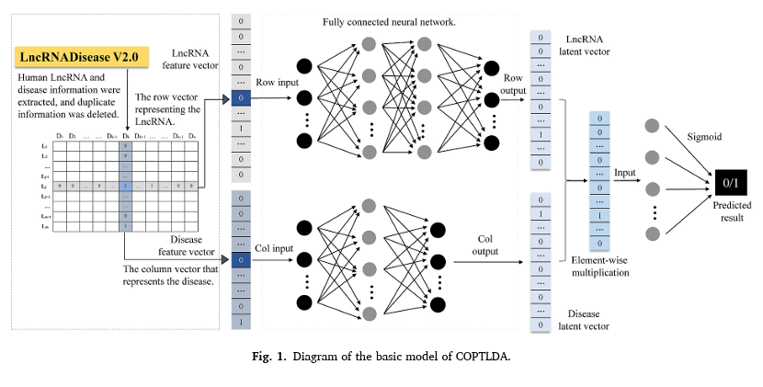
The Methodology
2 Step Method
COPTLDA

Slide 4
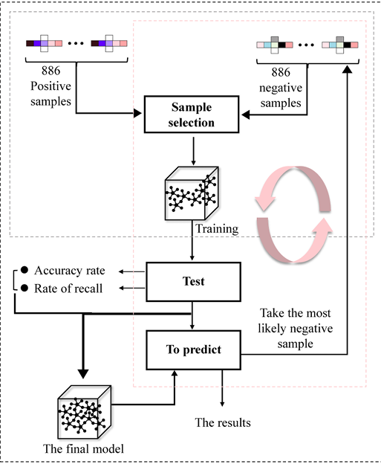
strategy of COPTLDA model

Slide 5
Conclusion
What we find
Future(biological data)

